Slide 1
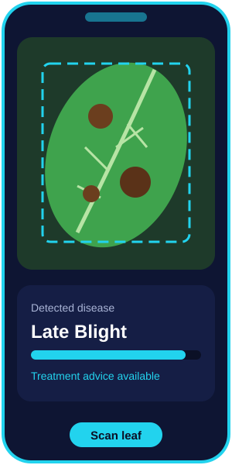
OPTIFORGE’26 • AI HACKATHON
LeafGuard AI
Instant crop disease detection from a phone photo, using a lightweight deep learning model
Theme: AI & Machine Learning
Team: [Team Name] | Members: [Names]
Vardhaman College of Engineering
Shamshabad | 30 Sep 2026
Illustrative app mockup
OptiForge’26 | AI & Machine Learning

Slide 2



The Problem
Small farmers lose crops because diseases are spotted too late
Late diagnosis
Limited expert access
Wrong treatment
Symptoms are noticed only after the disease has spread across the field.
Agri-experts are far away, costly or busy. Farmers rely on guesswork or shop advice.
Incorrect or excess pesticide raises cost, harms soil and cuts yield.
OptiForge’26 | AI & Machine Learning
2

Slide 3


Problem Statement & Solution
Problem statement
Design an accurate, lightweight ML model that identifies crop leaf diseases from a smartphone photo, works with low connectivity, and gives farmers clear treatment advice in their own language.
Our solution: LeafGuard AI
• Farmer clicks a leaf photo in the app
• A compressed CNN predicts the disease with a confidence score
• App shows treatment and prevention steps in English / Telugu / Hindi
• Runs on-device, so it works even without internet
OptiForge’26 | AI & Machine Learning
3

Slide 4





How It Works
Capture
Preprocess
Classify
Explain
Advise
Leaf photo from phone
Resize, normalise, augment
MobileNetV3 CNN
Grad-CAM highlights infected area
Treatment in local language
Input photo → Prediction + confidence + visual explanation + advice
OptiForge’26 | AI & Machine Learning
4

Slide 5

ML Approach & Algorithm
Model design
Training & evaluation
• Transfer learning: MobileNetV3 pre-trained on ImageNet
• Fine-tune on PlantVillage (about 54,000 leaf images, 38 classes)
• Augmentation: rotation, flip, brightness for field conditions
• Quantise to TensorFlow Lite for on-device speed
• Adam optimiser, cross-entropy loss, early stopping
• 70 / 15 / 15 train, validation, test split
• Metrics: accuracy, precision, recall, F1, confusion matrix
• Grad-CAM shows why the model decided, building farmer trust
OptiForge’26 | AI & Machine Learning
5

Slide 6

Tech Stack & Impact
Tech stack
Impact
• Python, TensorFlow / Keras
• TensorFlow Lite for mobile
• Streamlit or Flutter front end
• OpenCV for preprocessing
• Google Colab for training
• Earlier detection means less crop loss
• Right treatment lowers pesticide cost and soil damage
• Free, offline and multilingual, so any farmer can use it
• Scales to more crops by adding data
OptiForge’26 | AI & Machine Learning
6

Slide 7


Future Scope & Conclusion
Next steps
• Train on real field photos from Telangana crops (cotton, rice, chilli)
• Add pest detection and a voice assistant in Telugu
• Add weather-based outbreak alerts
LeafGuard AI puts an expert crop doctor in every farmer’s pocket.
Thank you | Questions?
OptiForge’26 | AI & Machine Learning
7

